Slide 1
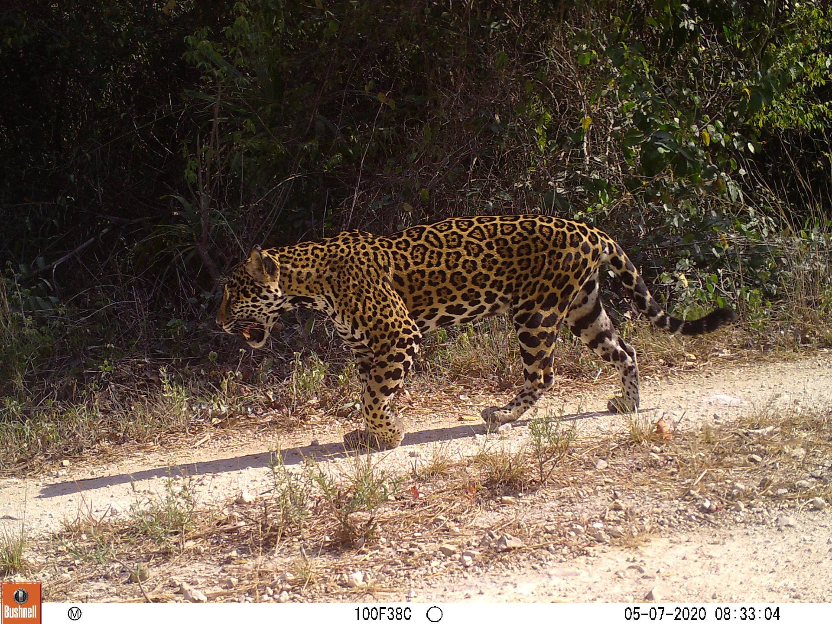
camtrapR
Jay M. Cooney

Slide 2
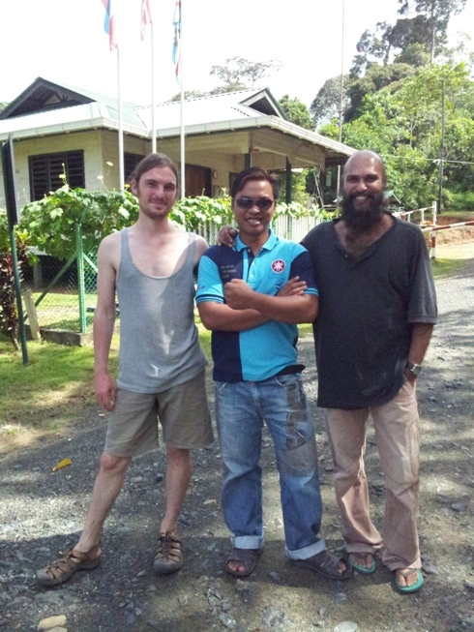
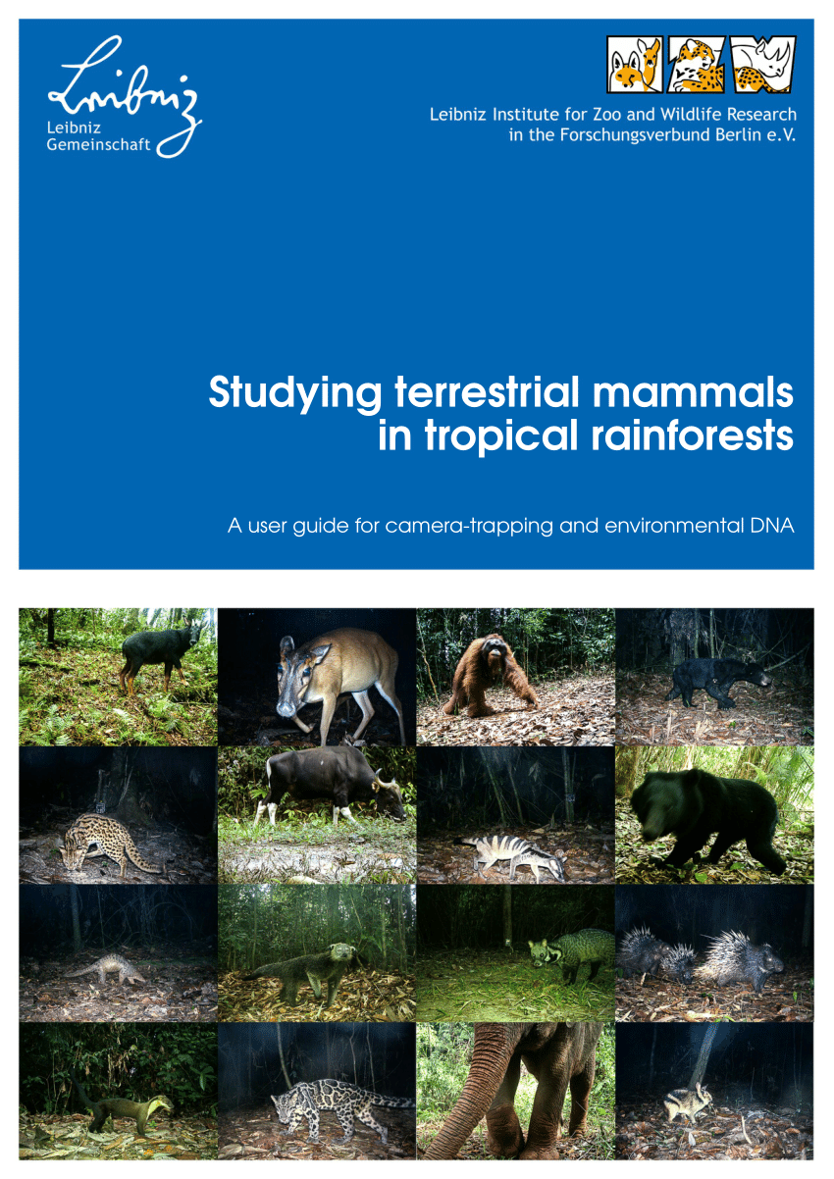
Lead Author: Jürgen Niedballa, PhD
Wildlife Ecologist studying mammals in Borneo
Uses Statistical Programming and Remote Sensing to study Mammal Spatial Ecology and Habitat Selection
PhD thesis (at F.U. Berlin) on “Managing and Analysing Camera Trapping Data: An Advanced Toolbox”
Most recent paper: A little-known endemic caught in the South-east Asian extinction crisis: the Annamite striped rabbit Nesolagus timminsi, published March 2020 in the journal Oryx

Slide 3
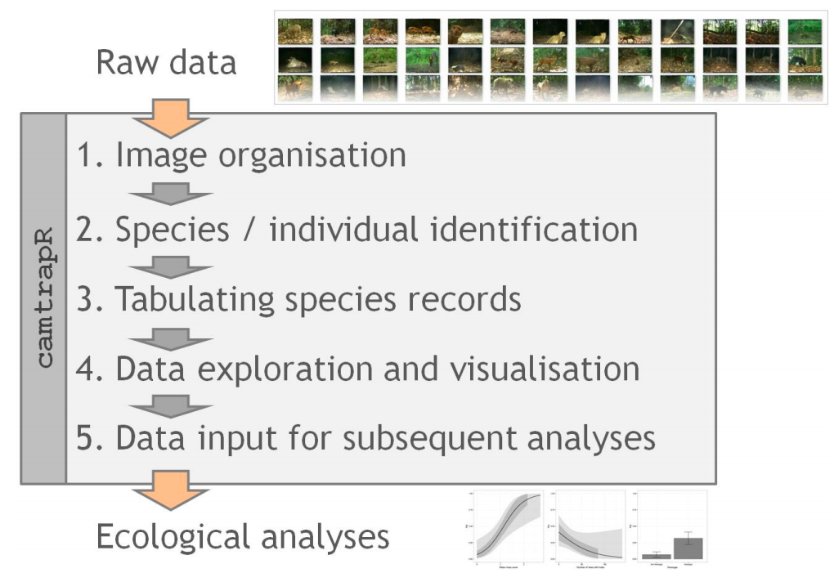
Introduction to camtrapR
Provides a workflow for managing and extracting data from large camera trap datasets

Slide 4
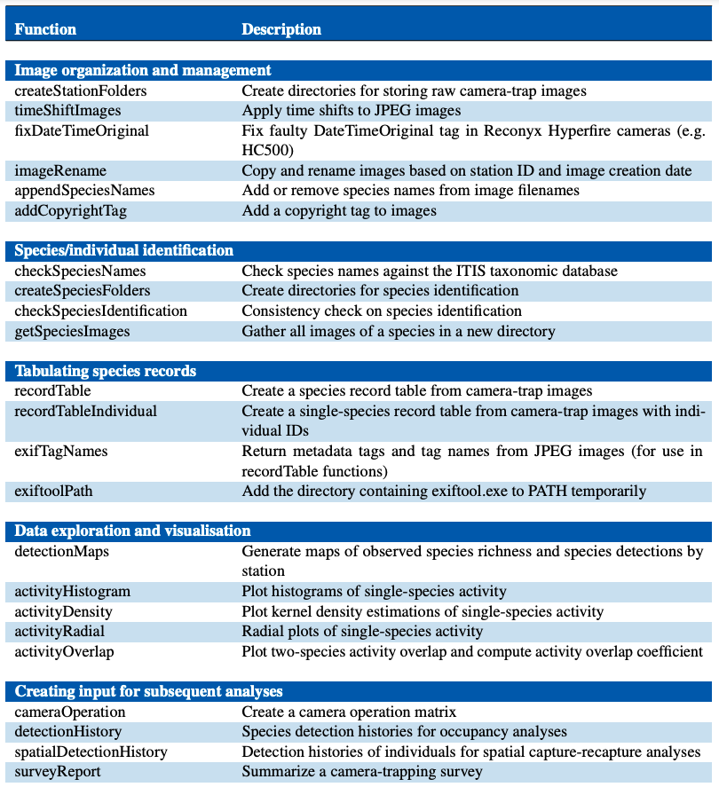
camtrapR Functions

Slide 5
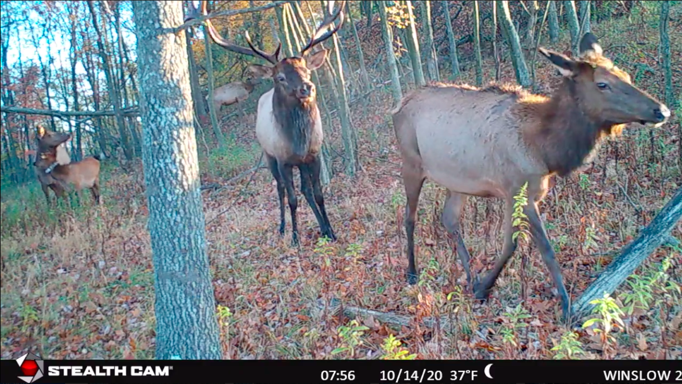
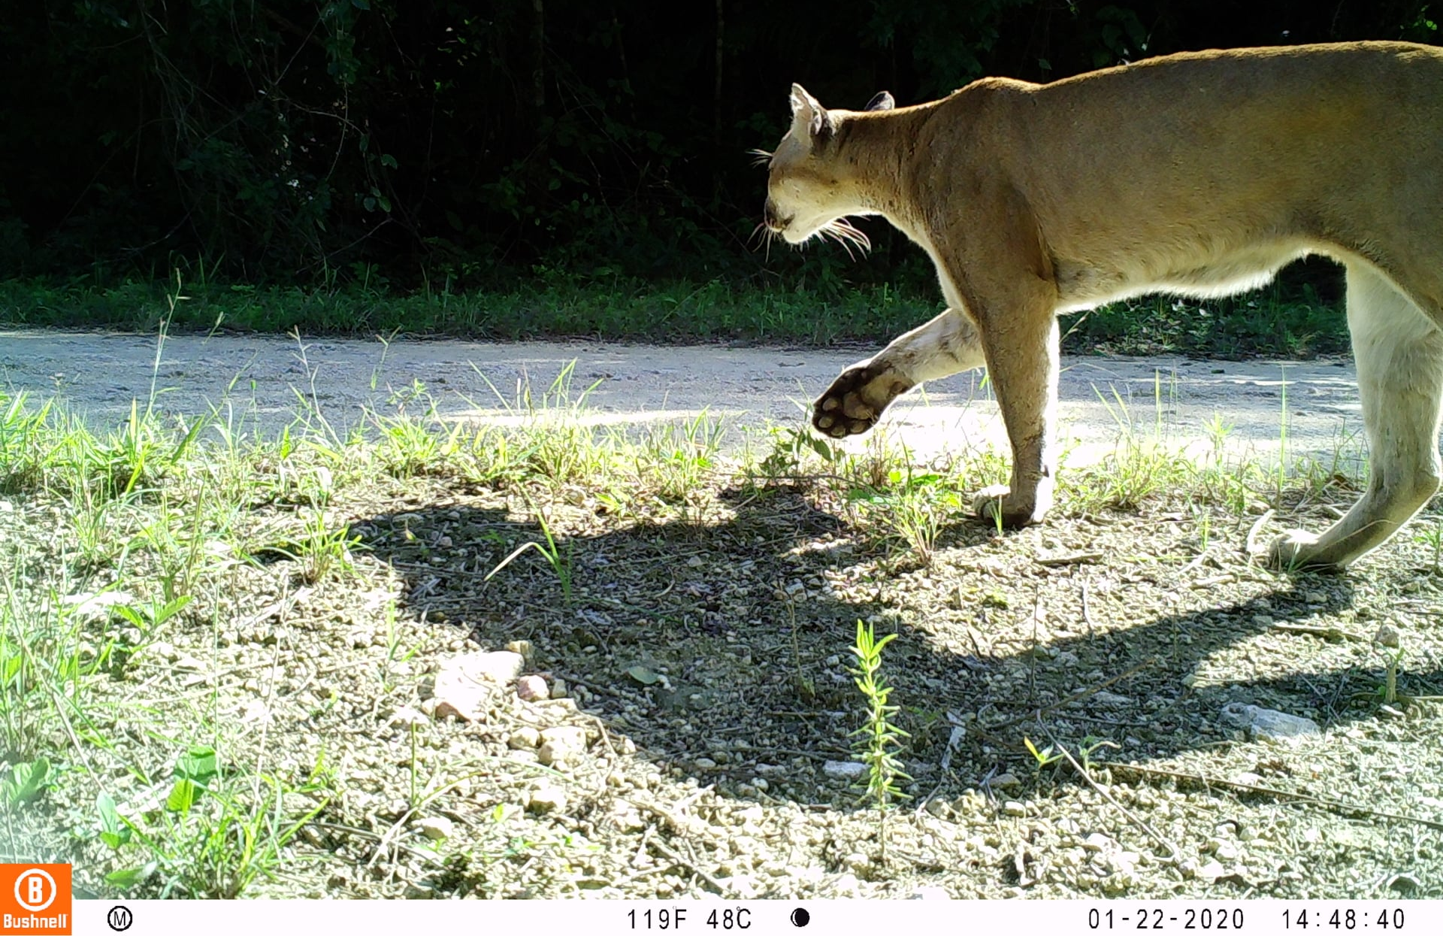
Data Visualization Functions
detectionMaps: Generate maps of species richness and species presence by station
activityOverlap: Two-species diel activity overlap plots and estimates

Slide 6
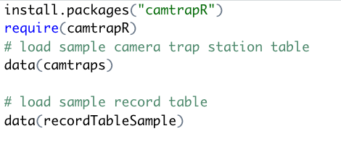
Data Visualization Functions

Slide 7
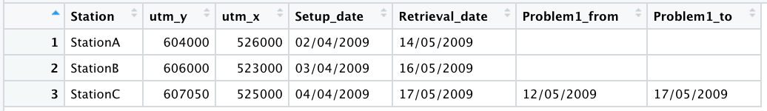
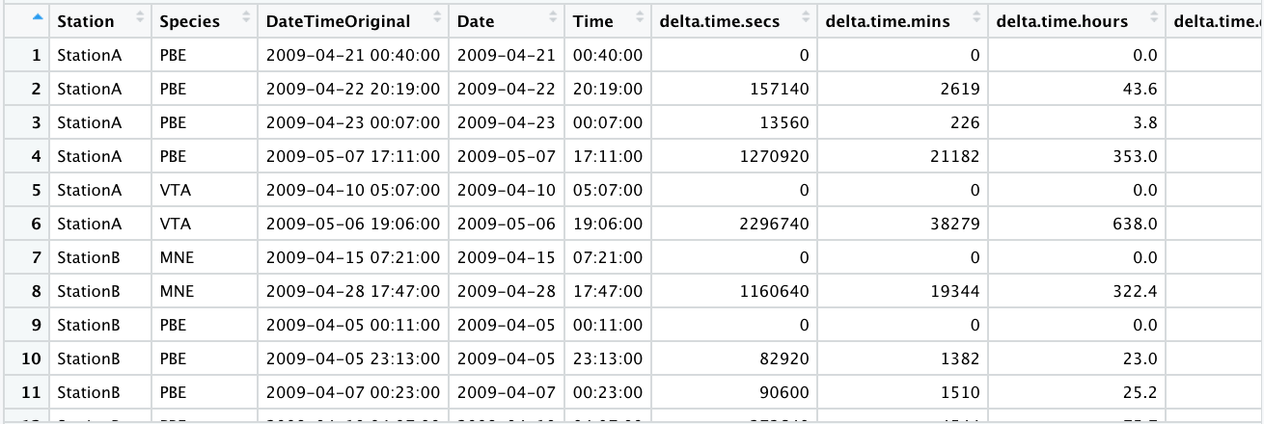
Data Visualization Functions

Slide 8
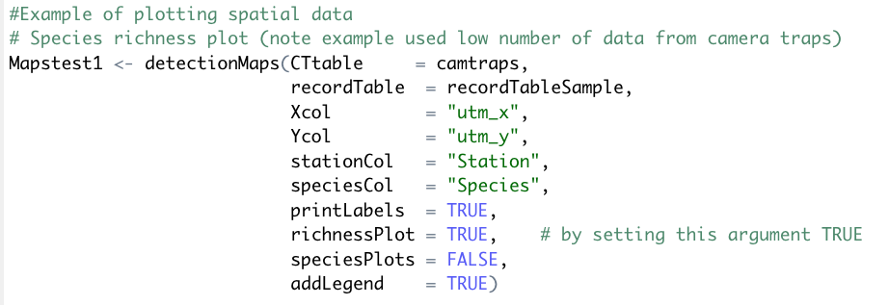
Detection Maps: Species Richness

Slide 9
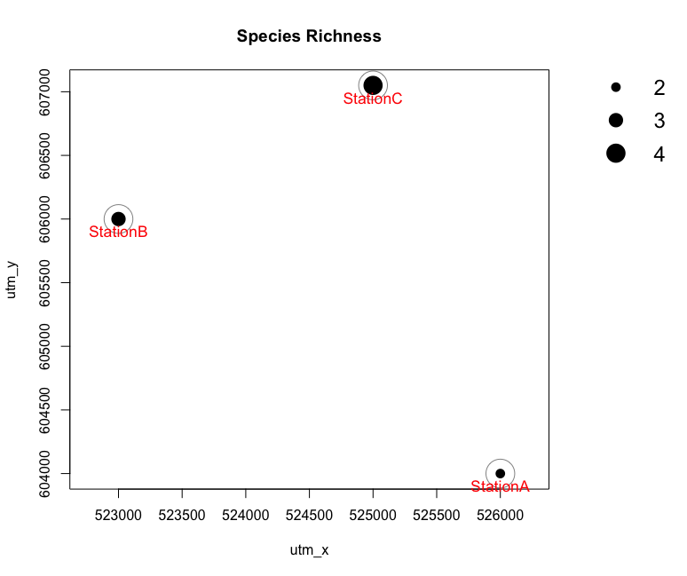
Detection Maps: Species Richness
Notes:
Visualize species activity patterns

Slide 10
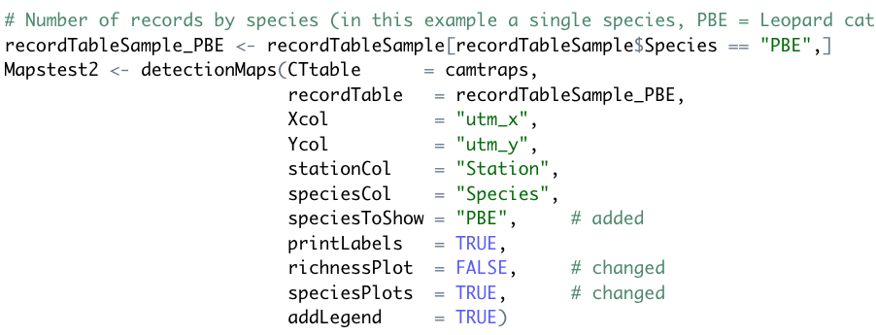
Detection Maps: Species Richness
Notes:
Visualize species activity patterns

Slide 11
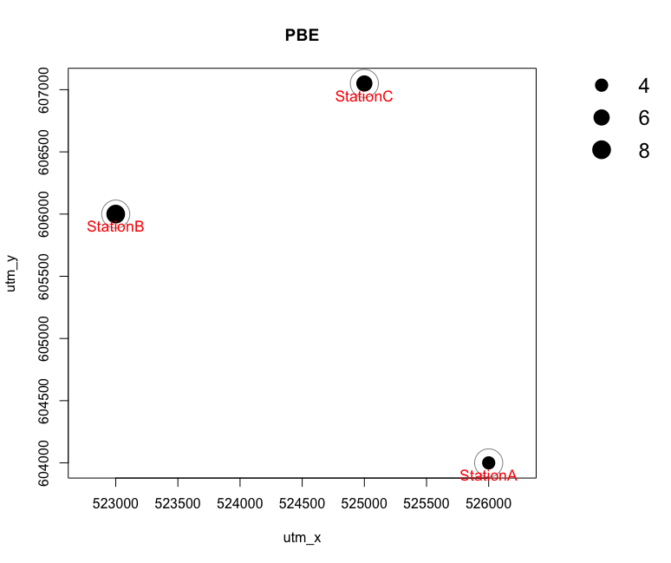
Detection Maps: Records by (Single) Species

Slide 12
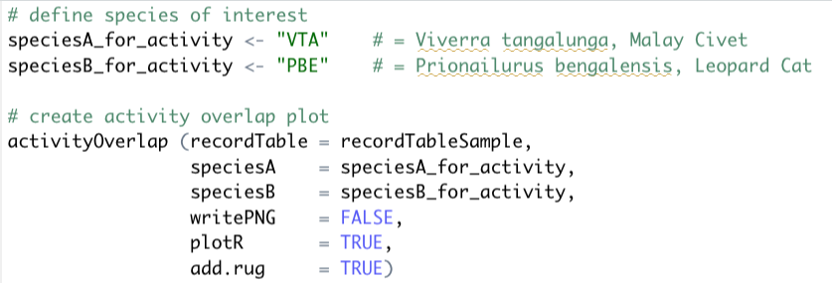
Activity Overlap

Slide 13
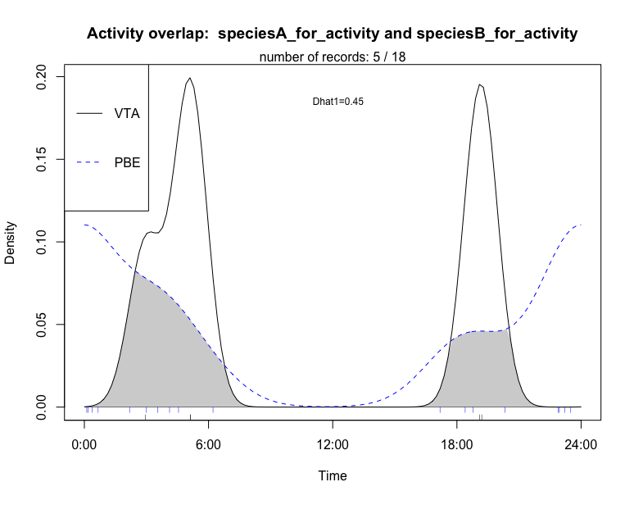
Activity Overlap

Slide 14
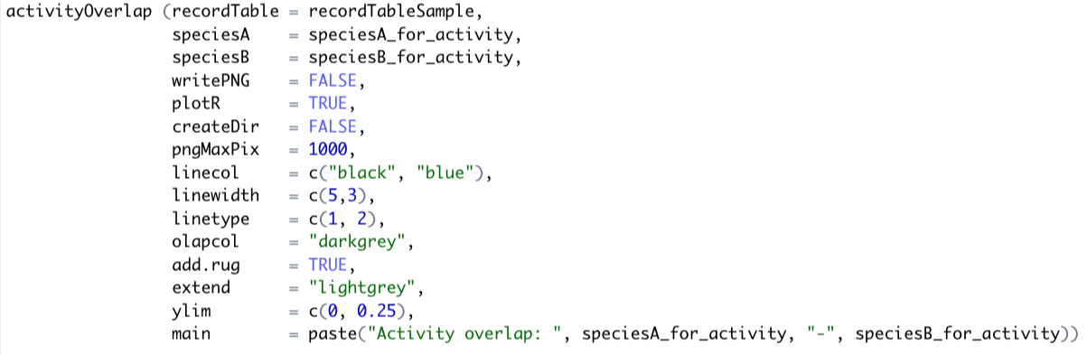
Activity Overlap

Slide 15
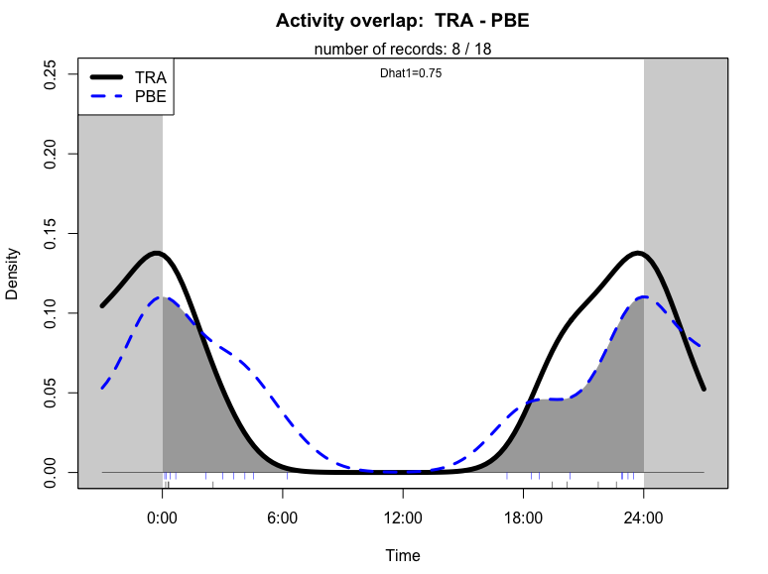
Activity Overlap

